Slide 1
Practice 4 - RTA for RM on uniprocessor

Slide 2
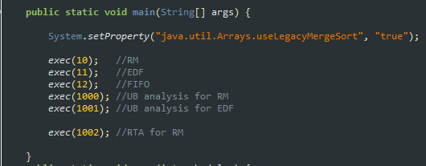
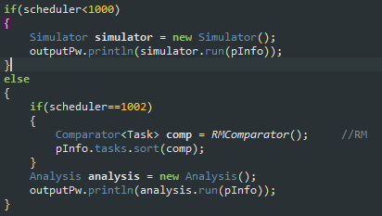

Response time analysis for RM
You should implement response time analysis for RM in CPUScheduler V2
Follow the following steps
Algorithm number should be 1002; modify _Exec_set.java as follows
Tasks in a task should be sorted by RM;
modify _Exec_set.java as follows

Slide 3
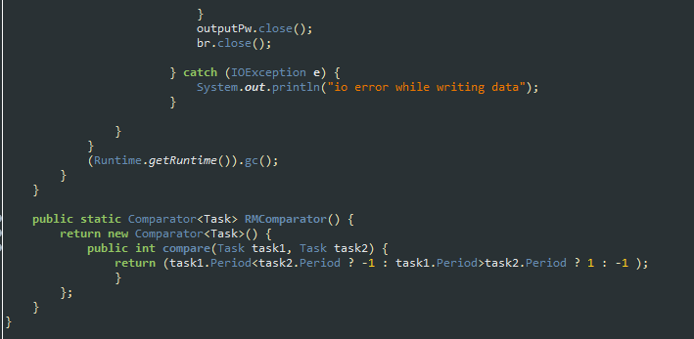
Response time analysis for RM
There should be RMComparator in _Exec_set.java; modify _Exec_set.java as follows

Slide 4
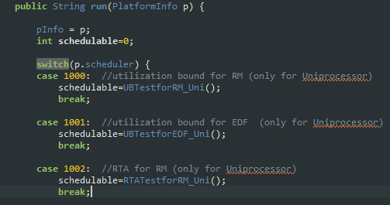
Response time analysis for RM
Analysis.java should contain “RTA for RM” code; modify Analysis.java as follows

Slide 5
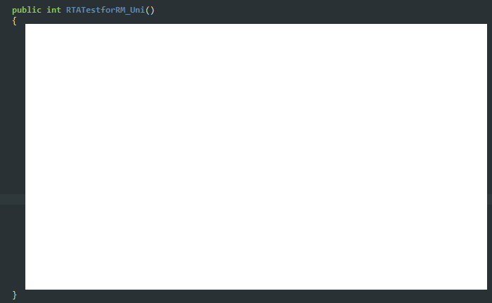
Response time analysis for RM
You should implement RTATestforRM_Uni(); modify Analysis.java

Slide 6
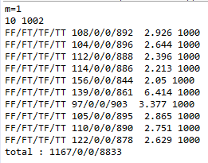
Response time analysis for RM
You will see the following result by execution __ResultCompare.java

Slide 7
Practice 4 HW
Submission files
Analysis.java (yours)
Captured output (in console window) figure; one that you saw in the previous slide
Description file (hwp or word file)
Firm deadline : refer to E-learning site
Instead, no delay is allowed
Delayed submission is graded as 0
Wrong output(source code as well) is graded as 0
Duplicated (from other peers) source code is graded as 'F‘
You should explain how to implement your source code in our class

